Slide 1
Now Control 2 BLDC Motors!
Ken Iiyoshi
ENGR-UH 3530
Embedded Systems
Fall 2019

Slide 2
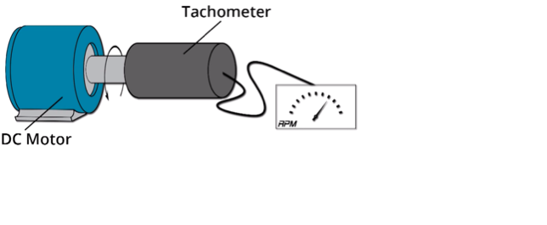
How can I measure motor speed?
Mechanical Tachometer
Used for car speedometers
Simple design
Source: https://www.youtube.com/watch?v=TzWbGhELqz4&t=2s

Slide 3
Problem
Requires DC motor w./o. Gear box
Shaft needs a flat side for screwing
Otherwise, coupler needs to be hot fitted
Requires system characterization. i.e. voltage to RPM transfer function.

Slide 4
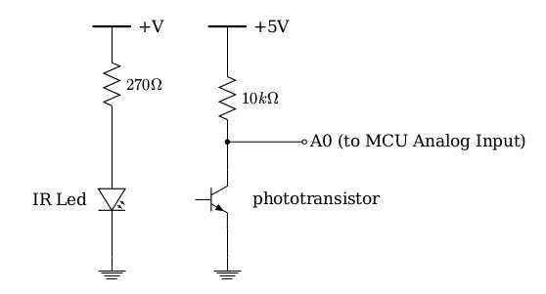
Easier Alternative
Phototransistor!
Source: https://electronics.stackexchange.com/questions/275161/understanding-voltage-and-current-of-a-phototransistor-w-collector-resistor

Slide 5
Using LED as a Phototransistor

Slide 6
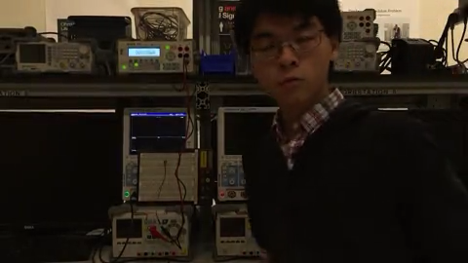

Slide 7
Now with BLDC

Slide 8
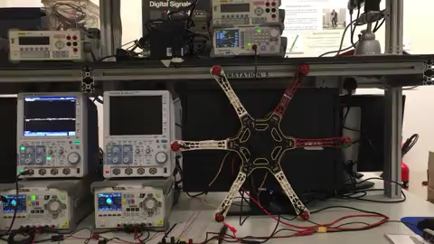

Slide 9
Need More Robust Set-up
960KV, 10V applied
Pulse width (ms) Frequency(Hz)
2: 145
1.7: 136
1.6: 133
1.5: 126
1.4: 110Hz
1.3: 90Hz
1.2: 45Hz

Slide 10
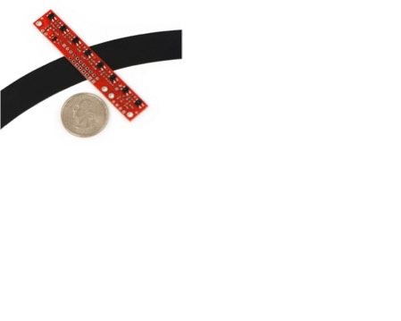
Use an Infrared Sensor!
IR Emitter + Phototransistor
Essential for line tracing robots.
Converts analog input into digital outputs.
Source: en.wikipedia.org/wiki/Brushless_DC_electric_motor

Slide 11
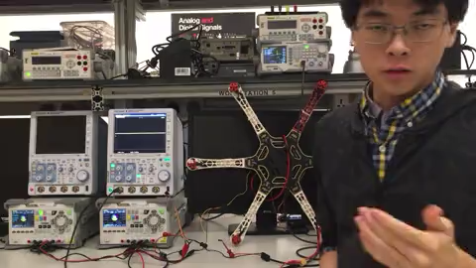

Slide 12
With ATmega328P microcontroller?

Slide 13
Controlling 2 BLDC
Recall ATmega328P Timers Labs:
Measure two motor PWMs
Input Capture
Output two motor PWMs
Output Compare
Not truly simultaneous
Source: ATMega328P Datasheet

Slide 14
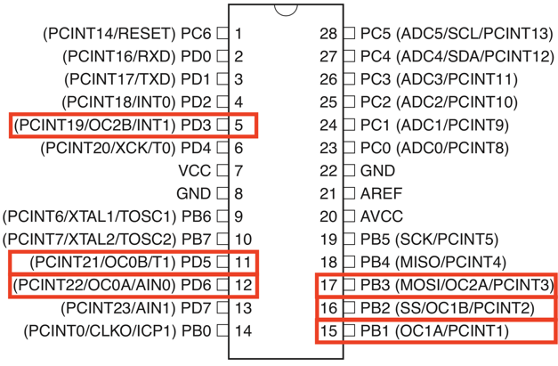
Which pin is for Input Capture?

Slide 15
Presentation 1 + Get & Display RPM
// Usual libraries and declarations omitted for ease of reading.
int main(void)
{
cli();
ADC_Init();
DDRB |= (1 << PINB1); // OC1A (Pin 9) as output. ICP1 (PB0) already as input.
PORTB &= ~(1 << PINB1);
_delay_ms(10000); // Gives me time to start the DC supply
TCNT0 = 0; // Initialize TCNT
ICR1 = 4999; // 50 Hz PWM = 16MHz / (64*(1+4999))
// clk/64, set fast PWM, TOP in ICR1, Clear OC1A on compare match (non-inverting)
TCCR0A = (1<<COM1A1) | (1<<WGM11);
TCCR0B = (1<<WGM13) | (1<<WGM12) | (1<<CS11) | (1<<CS10);
OCR10 = 40; // 0.8 ms. < 1ms to arm the BLDC motor
_delay_ms(2000); // 2 seconds buffer time.
// Read ADC0. Between 120-600 (2.4-12 ms pulse)
while(1) OCR0A = 120 + (ADC0_Read()/3.0);
// Configure Timer 1 for Input Capture
TCCR1A = 0x00; // OCR1A/B disconnected, normal mode
TCCR1B |= (1 << ICES1 ) | (1 << CS10); // Rising edge to trigger, prescaler 1 //0x41
TIMSK1 |= (1 << ICIE1) | (1 << TOIE1); // Enable IC interrupt, enable timer 1 overflow interrupt //0x21
sei();
char buf[MAX] = {0};
// sprintf stores the whole output into buf
sprintf(buf,"\r\n test: reading = %f\r\n", measured_rpm);
// send the content of buf to host PC’s Atmel’s Terminal extension
UARTserialWrite(buf);
}
// Timer 1 Input Capture Interrupt for keeping track of RPM.
ISR(TIMER1_CAPT_vect){
if(rising){
TCNT1 = 0x0000;
overflow = 0;
timerValue = 0;
rising = 0;
TIFR1 |= (1 << TOV1);
TIMSK1 |= (1 << TOIE1);
}
else{
timerValue = ICR1 + (overflow * 0x10000UL);
measured_rpm = measured_rpm + 1; Increment rpm count
rising = 1;
TIMSK1 &= ~(1 << TOIE1);
}
TCCR1B ^= (1 << ICES1); // Switch the trigger edge
}
}
// Timer 1 Overflow Interrupt Response for resetting measured_rpm.
ISR(TIMER1_OVF_vect){measured_rpm = 0;}

Slide 16
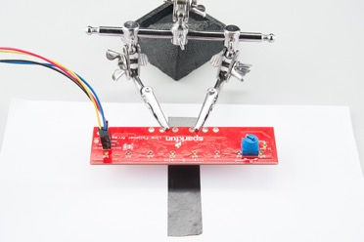
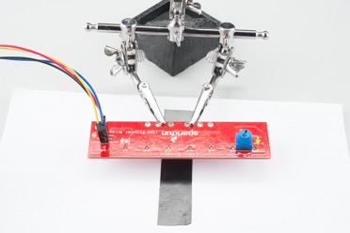
Drawback of IR sensor
Noisy
Susceptible to external light and dust
When the IR Power is too low, the sensor recognizes some white background as black line.
When the IR Power is too high, the sensor recognizes some black surface as white background.

Slide 17
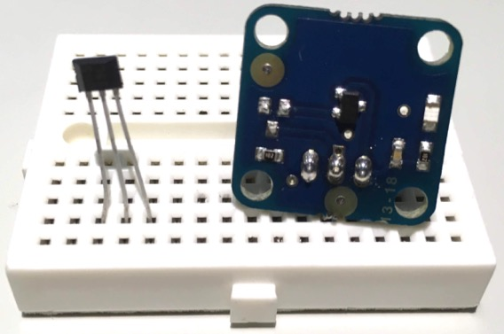
Even Better Alternative: Hall Sensors!
Module from Arduino Engineering Kit
Typical Hall Sensor

Slide 18
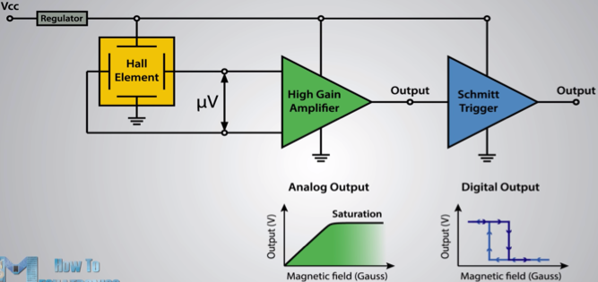
Hall Sensor Overview
3 Pins: VCC, GND, Output
VCC powers Hall Effect
Schmitt trigger converts analog input to digital output
Source:https://maker.pro/arduino/tutorial/how-to-use-a-hall-effect-sensor-with-arduino

Slide 19
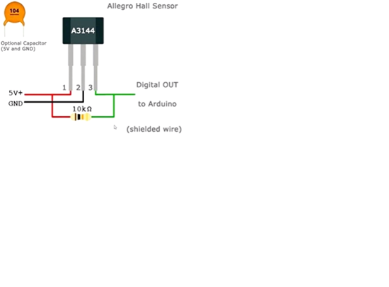
Connection
10K resistor pulls the output to 5V
Optional capacitor for reducing effect from signal noise.
Source:https://maker.pro/arduino/tutorial/how-to-use-a-hall-effect-sensor-with-arduino

Slide 20
Code stays the same!
// Usual libraries and declarations omitted for ease of reading.
int main(void)
{
cli();
ADC_Init();
DDRB |= (1 << PINB1); // OC1A (Pin 9) as output. ICP1 (PB0) already as input.
PORTB &= ~(1 << PINB1);
_delay_ms(10000); // Gives me time to start the DC supply
TCNT0 = 0; // Initialize TCNT
ICR1 = 4999; // 50 Hz PWM = 16MHz / (64*(1+4999))
// clk/64, set fast PWM, TOP in ICR1, Clear OC1A on compare match (non-inverting)
TCCR0A = (1<<COM1A1) | (1<<WGM11);
TCCR0B = (1<<WGM13) | (1<<WGM12) | (1<<CS11) | (1<<CS10);
OCR10 = 40; // 0.8 ms. < 1ms to arm the BLDC motor
_delay_ms(2000); // 2 seconds buffer time.
// Read ADC0. Between 120-600 (2.4-12 ms pulse)
while(1) OCR0A = 120 + (ADC0_Read()/3.0);
// Configure Timer 1 for Input Capture
TCCR1A = 0x00; // OCR1A/B disconnected, normal mode
TCCR1B |= (1 << ICES1 ) | (1 << CS10); // Rising edge to trigger, prescaler 1 //0x41
TIMSK1 |= (1 << ICIE1) | (1 << TOIE1); // Enable IC interrupt, enable timer 1 overflow interrupt //0x21
sei();
char buf[MAX] = {0};
// sprintf stores the whole output into buf
sprintf(buf,"\r\n test: reading = %f\r\n", measured_rpm);
// send the content of buf to host PC’s Atmel’s Terminal extension
UARTserialWrite(buf);
}
// Timer 1 Input Capture Interrupt for keeping track of RPM.
ISR(TIMER1_CAPT_vect){
if(rising){
TCNT1 = 0x0000;
overflow = 0;
timerValue = 0;
rising = 0;
TIFR1 |= (1 << TOV1);
TIMSK1 |= (1 << TOIE1);
}
else{
timerValue = ICR1 + (overflow * 0x10000UL);
measured_rpm = measured_rpm + 1; Increment rpm count
rising = 1;
TIMSK1 &= ~(1 << TOIE1);
}
TCCR1B ^= (1 << ICES1); // Switch the trigger edge
}
}
// Timer 1 Overflow Interrupt Response for resetting measured_rpm.
ISR(TIMER1_OVF_vect){measured_rpm = 0;}

Slide 21
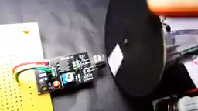
Future work
Add 2nd motor via OCR2A register.
Requires another Input Capture Module, either through two motors sharing one input capture, or two Atmega328P chips.
Synchronize RPM based on hall sensor readings and their offset from designated value.
Example RPM Tracking of a Single Motor
Source: https://www.instructables.com/id/Ho-to-Make-Arduino-Based-Digital-Tachometer-Simple/
Notes:
Note that the video’s RPM display is on a LCD, but my code would display the same value on a I2C connected computer.

Slide 22
REFERENCES
https://maker.pro/arduino/tutorial/how-to-use-a-hall-effect-sensor-with-arduino
https://maker.pro/arduino/tutorial/how-to-use-a-hall-effect-sensor-with-arduino
https://www.youtube.com/watch?v=gVl4B7NDnQY&t=318s
https://electronics.stackexchange.com/questions/275161/understanding-voltage-and-current-of-a-phototransistor-w-collector-resistor
How to connect resistor to hall sensor:
https://maker.pro/arduino/tutorial/how-to-use-a-hall-effect-sensor-with-arduino
Datasheets
Pololu QTR-8A and QTR-8RC Reflectance Sensor
dji 2212 920KV Brushless Motor
Dji 30A opto ESC
ATMega328P

Slide 23
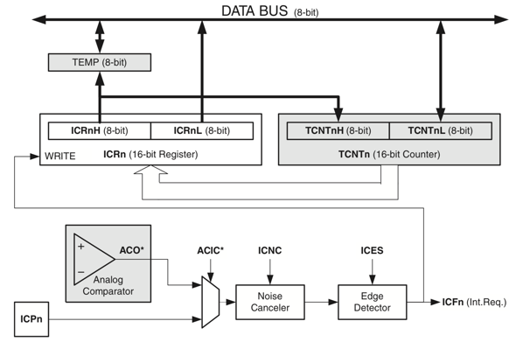
Appendix A: ATmega328P 16-bit Timer Input Capture Unit

Slide 24
Appendix B: Potentiometer-Controlled BLDC from Presentation 1. (Base of presentation 2 code)

Slide 25
#define F_CPU 16000000ul
#include <avr/io.h>
#include <util/delay.h>
#include <avr/interrupt.h>
int main(void)
{
ADC_Init();
DDRB |= (1 << PINB1); // Set OC1A (Pin 9) as output
PORTB &= ~(1 << PINB1);
_delay_ms(10000); // Gives me time to start the DC supply
TCNT1 = 0; // Initialize TCNT1
ICR1 = 4999; // 50 Hz PWM = 16MHz / (64*(1+4999))
// clk/64, set fast PWM, TOP in ICR1, Clear OC1A on compare match (non-inverting)
TCCR1A = (1<<COM1A1) | (1<<WGM11);
TCCR1B = (1<<WGM13) | (1<<WGM12) | (1<<CS11) | (1<<CS10);
OCR1A = 40; // 0.8 ms. < 1ms to arm the BLDC motor
_delay_ms(2000); // 5 seconds buffer time.
// Read ADC0. Between 120-600 (2.4-12 ms pulse)
while(1) OCR1A = 120 + (ADC0_Read()/3.0);
}
void ADC_Init()
{
DDRC=0x00; //Make ADC port as input
// Enable ADC, with freq/128 now 2
ADCSRA = (1 << ADEN) | (1 << ADPS2) | (1 << ADPS1) | (1 << ADPS0);
// AVcc as Reference voltage, ADC0 as input
ADMUX = (1 << REFS0);
}
int ADC0_Read()
{
ADMUX = (1 << REFS0); // Set ADC0 to read
ADCSRA |= (1<<ADSC); // Start ADC conversion
// Wait until end of conversion by polling ADC interrupt flag
while (!(ADCSRA & (1<<ADIF)));
ADCSRA |= (1<<ADIF); // Clear interrupt flag
_delay_ms(1); // Wait a little bit
return ADCW; // Return ADC data register
}

